Slide 1
Practical Exam Presentation
New Product Sales Methods - Pens and Printers

Slide 2
Business Goal
Knowing a little more about the company and given the context provided the business objective of Pens and Printers, it could be:
Expanding the product portfolio and increasing sales
Optimize marketing and sales strategies
Assess profitability and efficiency
Notes:
Expand product portfolio and increase sales: Since they are launching a new product line and mention that sales tactics must adapt as the ways in which consumers shop change, their main objective could be to expand their product offering and increase the company's overall sales. This means increasing market share and generating higher revenues.
Optimize marketing and sales strategies: Since they mention that they need to learn quickly which approaches work best for each new product, another objective could be to optimize their marketing and sales strategies. This involves identifying the most effective techniques for promoting and selling new products, which in turn will contribute to the company's success.
Assess profitability and efficiency: Since they mention that launching a new product line is costly, an important objective could be to assess the profitability and efficiency of operations. This involves making sure that they are using their resources effectively and that the new products are profitable.

Slide 3
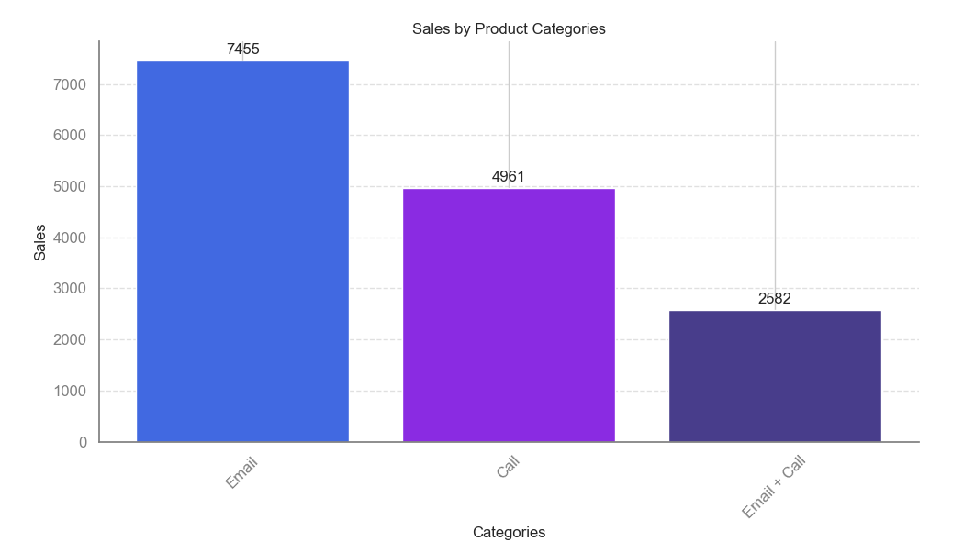
Outcomes
How many customers were there for each approach?
Out of the 14998 customers in the database, the sales method that attracted the largest customers was email, followed by phone calls, and lastly, a combination of email and phone calls.
Notes:
For this task you want to know:
How many customers were there for each approach?
The most effective sales approach among the 14.998 customers in the database was email, with phone calls coming in second, and a combination of both email and phone calls being the least effective in attracting customers.

Slide 4
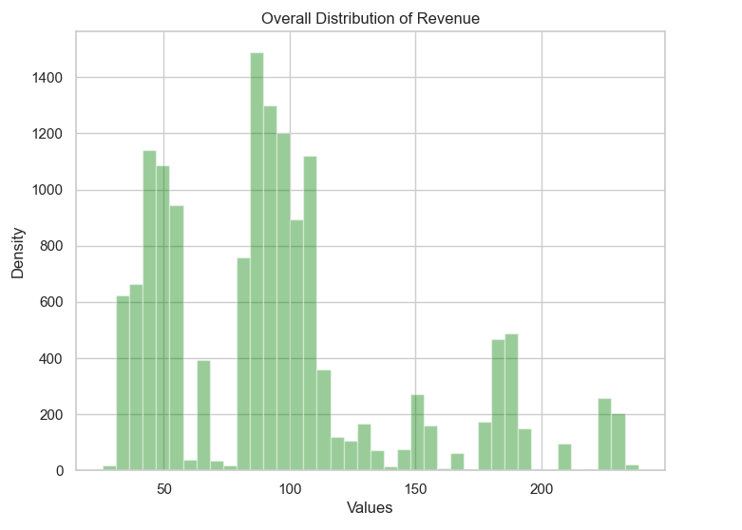
Outcomes
What does the spread of the revenue look like overall? And for each method?
From the overall distribution plot, it can be observed that the majority of sales made in the last 6 weeks are less than 191.6. Values greater than this amount may be considered outliers.

Slide 5
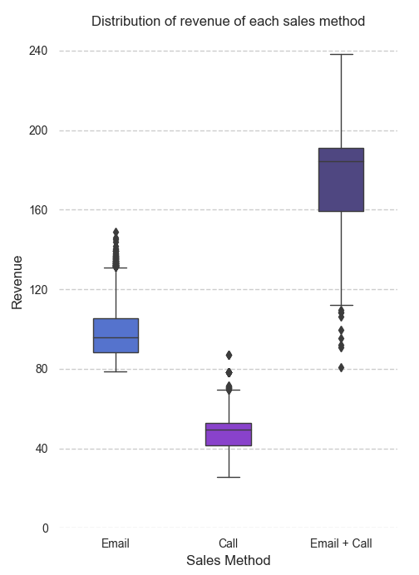
Outcomes
What does the spread of the revenue look like overall? And for each method?
Sales distribution summary by method:
Email: Most customers fall within the range of 88.1 to 105.2.
Phone calls: The majority of sales range from 41.5 to 52.7.
Email + Call: Sales are distributed between 164.4 and 191.3 for this method.
Notes:
In the other hand, the distribution across sales methods is as follows: For Email, which had the highest number of customers, most of the sales fall between 87.8 and 105.2. For phone calls, which ranked second, the distribution is between 41.5 and 52.7. Finally, for Email + Call, ranking third in the number of customers, it is distributed between 155.7 and 191.1.

Slide 6
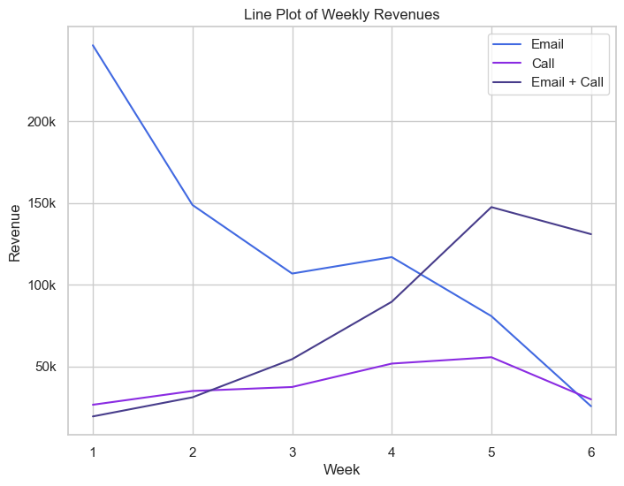
Outcomes
Was there any difference in revenue over time for each of the methods?
Sales trends:
Email: Sales start strong at around 100,000 in the first 4 weeks, but then decline.
Phone calls: Maintain a consistent average of 38,000 over the first 6 weeks.
Email + Call: Initially low, but shows a rising trend, eventually surpassing 100,000 in sales.
Notes:
The graph above shows that during the first 4 weeks, the email generates sales of around 100,000 or more, which after this week starts to decline. On the other hand, calls maintain an average sales of 38,000 during the first 6 weeks, with a somewhat constant behavior during this period. Finally, the email + call method starts with few sales in the first weeks, but then has an increasing behavior generating sales over 100,000.

Slide 7
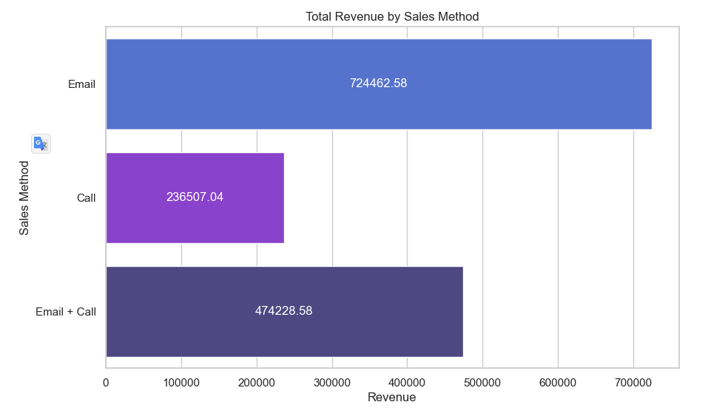
Final Outcome and Business Metric
Based on the data, which method would you recommend we continue to use?
Considering the graph and factoring in the time required for each sales method, it is advisable to prioritize the email method and the email + call method. These approaches yield higher revenue while being more time-efficient compared to other methods.
Notes:
Based on the above graph, and taking into account the time it takes a worker to employ a sales method, I would focus more efforts on both the email method and the email + call method, since they generate more revenue and do not take as much time
Business wants to know what went well in the different sales methods and customers, I recommend using the **Profits realized in the first 6 weeks of launching a product to market by different method** (the last graph shown).
If these numbers are exceeded, it indicates that it is a good sign of the goal achieved.

Slide 8



Recomendation
Focus on:
Email: This required very little work for the team.
Email + Call: The email required little work from the team, the call was around ten minutes per customer
Avoid:
On average members of the team were on the phone for around thirty minutes per customer.
Notes:
If I had to eliminate one sales method, in order to use that time as effort for another method, I would eliminate calling, as it takes about 30 minutes per customer and the data showed that it was the lowest earning compared to the other two methods.

Slide 9
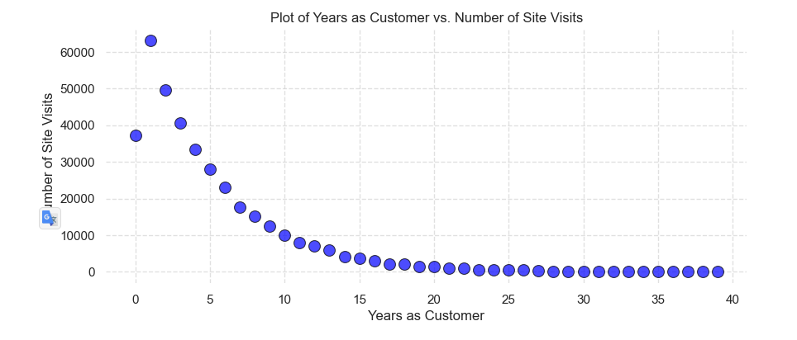
Recomendation
Additionally, maintaining an updated website can simplify work for your team and attract new customers by keeping them informed about new products.
Notes:
ddition, knowing that the other two methods usually use email, I would also invest time in keeping the website updated as it allows customers to keep abreast of new products and even attract new customers by facilitating the work of workers.

